Slide 1
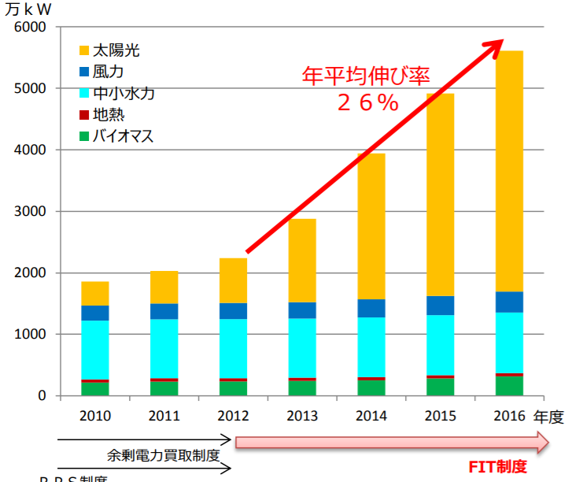
Power Quality Group (QG)
MEMBER
Dita:PD, Jirada:D2, Ozawa:M1, Sato:M1, Tonouchi:B4, Hatano:B4
【Background】
Global Warning, Paris Agreement, FIT System, etc.
➣ Increase amount introduced of Renewable Energy
If the capacity of the inverter type distributed power generation exceeds the capacity of the main power generation
Power System is unstable by lack of Inertial
Solution method
Virtual Synchronous Generator Control
(VSG Control)
Transition of installed capacity
by Renewable Energy
What is Inertial of Power System?
Oscillation Equation of Synchronous Generator
What is VSG Control ?
Frequency in Power System is determined by number of rotations of Synchronous Generator, while it changes by difference between Mechanical Input and Electrical Output.
When Inertial(Rotor Weight) is large, the change of number of rotations becomes small. Therefore, Inertial of Synchronous Generator is an important factor in stabilizing Power System.
$$M\frac{d^{2}θ}{{dt}^{2}}=P_{m}−P_{e}$$
VSG Control gives pseudo Inertial Power to an inverter
to prepare it the same characteristics as Rotary Synchronous Generator.
$M:$Inertial Constant[kW$∙$s]
$θ:$Phase Angle[rad]
$P_{m}:$Mechanical Input[kW]
$P_{e}:$Electrical Output[kW]

Slide 2
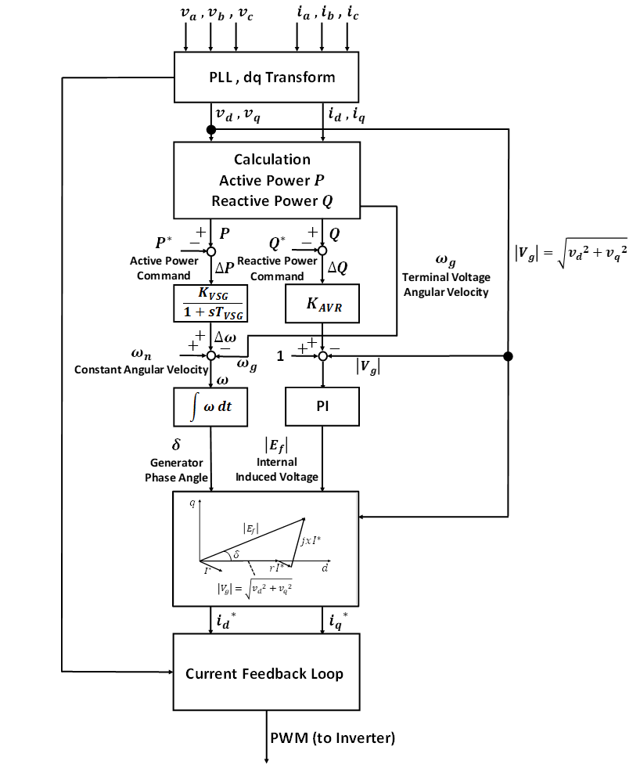
【Research Theme】
Design of Small Capacity VSG Control Inverter （B4:Hatano）
【Research Purpose】
✓Construction of experiment device of small capacity VSG Control Inverter in laboratory scale
✓Analysis of grid introduction effect of VSG Control Inverter at grid load fluctuation
【Research Plans】
STEP1
Check Coupled Operation of PSIM and Simulink
STEP2
Investigation on Governor Characteristic, Oscillation Equation, AVR(Auto Voltage Regulator) and Droop Control of Synchronous Generator and dq transform and PLL(Phase Locked Loop)
STEP3
Construction and evaluation of simulation model of VSG Control
STEP4
Construction of control circuit of VSG Control for actual machine
STEP5
Comparison and evaluation of actual machine results and simulation results
Flow of VSG Control
Reference : Research on parallel operation of Virtual Synchronous Generator Control Inverter (Osaka University, Yuko Hirase, in 2016)

Slide 3
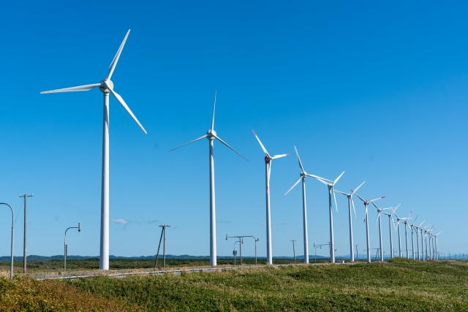
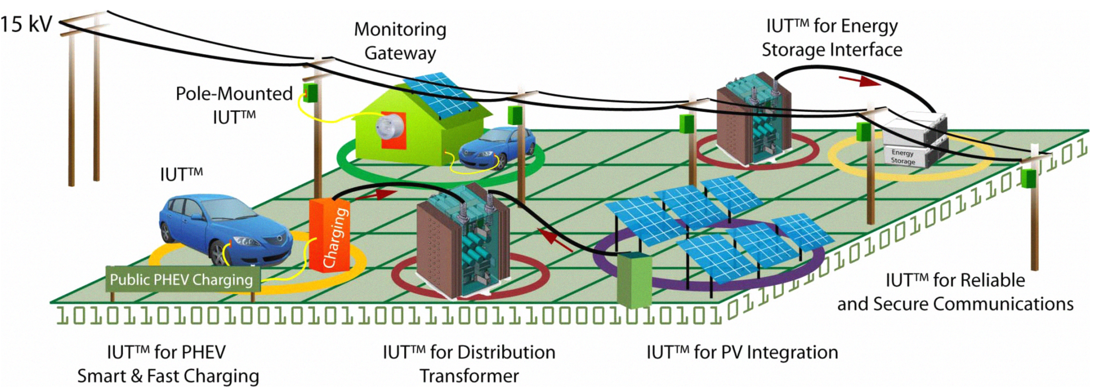
【Background】
Increased renewable energy and distributed power sources into the grid
Conventional transformers convert high voltage for long distance transportation into low voltage required by homes and businesses.(Only one direction)
New technologies are required to allow multiple number of inputs and bidirectional power flow.
Smart grid needs bidirectional power flow
One of power interchange device is Solid State Transformer (SST)
SST is a power electronic device that can convert AC (or DC) to AC (or DC)

Slide 4
Overview of SST
 | Conventional Transformer | Solid State Transformer
Frequency for input - output | Same | Different
Voltage ratio | Fixed | Flexible
Input - Output | AC | AC or DC
Efficiency | Up-to-99.5％ | Up-to-98.7％
【Research theme】
Investigate the control method to produce SST and verify its effectiveness
（B4:Tonouchi）
Research Plans
Simulation and experiment
Modularization
Bidirectional power flow(DC-DC converter)
DC output voltage follows the desired value(AC-DC converter)
AC output voltage follows the desired value(DC-AC converter)
Voltage THD < 5%
Control power factor to 1
Grid connected mode
Islanding mode

