Slide 1
Experiment Group (EG)
MEMBER
Zama :B4
Research Background
Distributed power supply has become widespread due to the adoption of smart grids.
In verification using simulation using a real machine, it is difficult to assume various situations.
Research Purpose
I want to simulate various situations using a generator.
A device that can easily be simulated doesn’t exist
Make equipment and build experiments
出典：横山明彦：スマートグリッド(電気新聞ブックス)

Slide 2
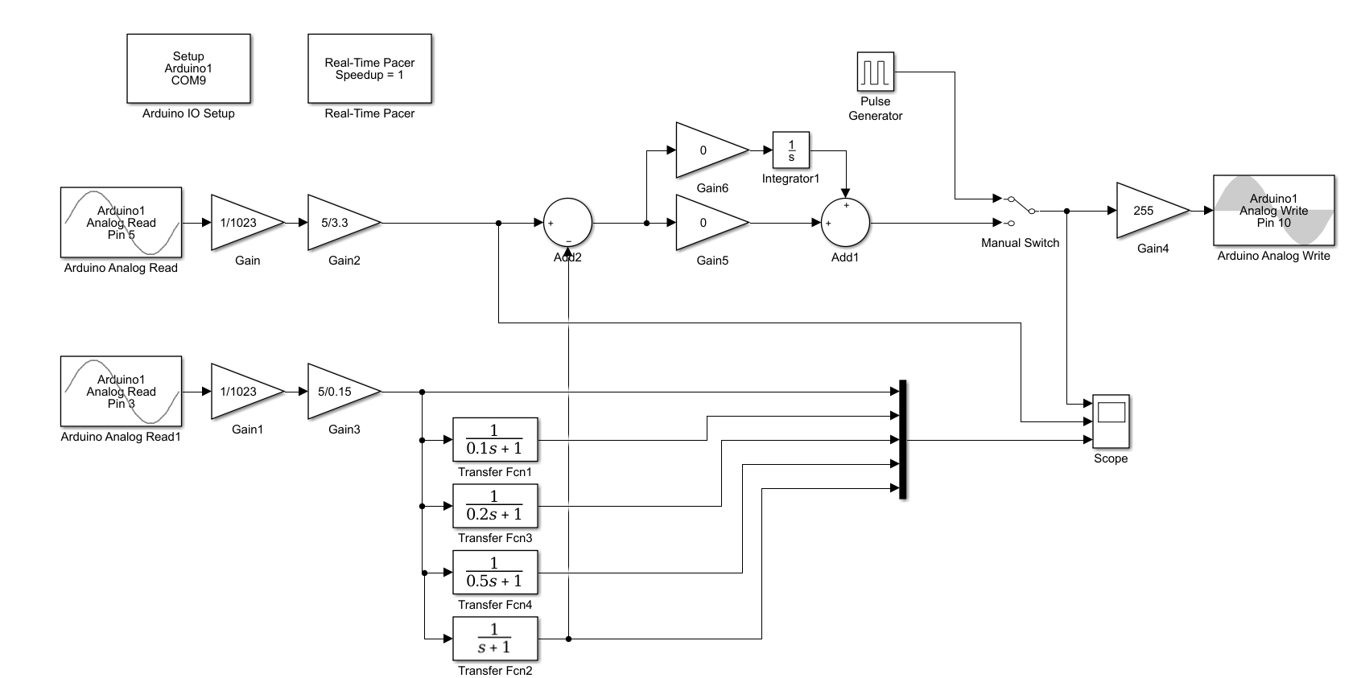
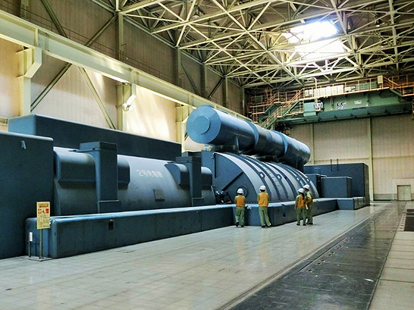
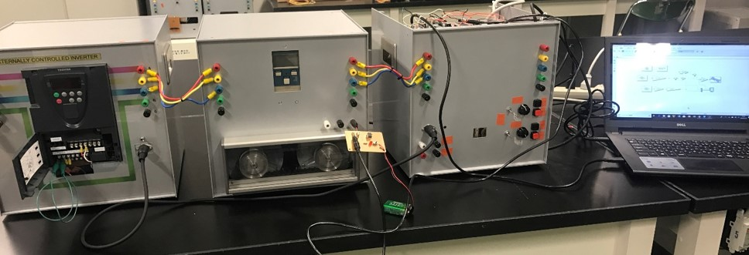
Target image
Turbine generator
AVR ・ GOV control system
The turbine type generator can be controlled by module using Arduino etc.
INV
IM-SG
Controller
Speed
Arduino
Excitation voltage
Speed
Voltage Command
Speed Command
Speed
Voltage
LabVIEW
Scene of experiment
Small-Scale Experiment system

Slide 3
Production content
IM-SG set
Controller
Speed
Voltage
sensor
Excitation Voltage to IM-SG
～rpm
Transistor circuit
AVR
GOV
voltage
NI
DAQ
Arduino
Target value command
Speed
Voltage
Stand Alone Mode
LabVIEW
Output to Controller
IM
SG
IM-SG set
The rotational speed is measured using a magnetic sensor, and the measured rotational speed is output to the controller.
Controller
Command voltage and rotational speed from the controller. Also, by connecting to LabVIEW, the waveform etc. being measured are displayed.
External Mode
Function
 | Stand Alone Mode ( only Arduino ) | External Mode ( with NI DAQ )
Normal operation | ✔ | ✔
High-performance operation | ✔ | ✔
Droop control |  | ✔
Virtual inertia |  | ✔
GOV & Excitor Model |  | ✔

Slide 4
Research theme
Construction of an experimental system simulating a small synchronous generator
Purpose of research
Produce a small power generation unit that can simulate a power plant in laboratory.
Research plan
Create panel design of IM-SG set
Assembly of IM-SG set
Operation check of IM-SG set
Confirmation about GOV control
Operation check with inverter, IM-SG set and controller
Examination of AVR control
Step7
Step6
Step5
Step4
Step3
Step2
Step1
Internal production of IM-SG set

