Slide 1
Battery Control Group
Member Pradita(PD), Sandro(D1), Hanawa(B4)
【Background】
・Diesel generator(DG) is the main source in isolated islands
・The cost of diesel generation is expensive
・The operation of diesel generator adversely influences the environment
The introduction of renewable energy is promoted
【Problem】
Large introduction of renewable energy affects the system stability
Battery control
Supply and demand image of remote island
Enlarged view(without battery)
Enlarged view(with battery)
Supply
PV
Demand
Demand
【Solution】
Demand
Supply
Stabilize the system by introducing battery
DG
h
Sudden changes by PV
Leveling sudden changes by battery
Fig.1 Image to control PV output fluctuation by battery^{[1]}
Ref[1]:Kyushu Electric Power Company『http://www.kyuden.co.jp/press_h130329d-1]』

Slide 2
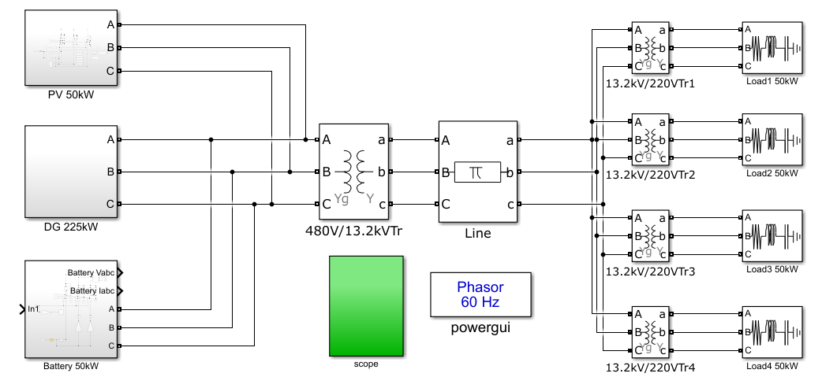
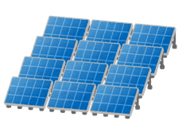
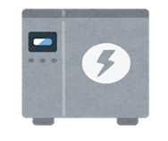
【Previous research】
Analyzed the following two patterns
①When PV output falls sharply while demand is constant
②When PV output falls sharply at the same time as the demand increases
Result
Fig.2 Simulation model
The battery was able to control the PV output fluctuation and the change of demand
But
The cost of battery is high, so operation cost of system increases

Slide 3
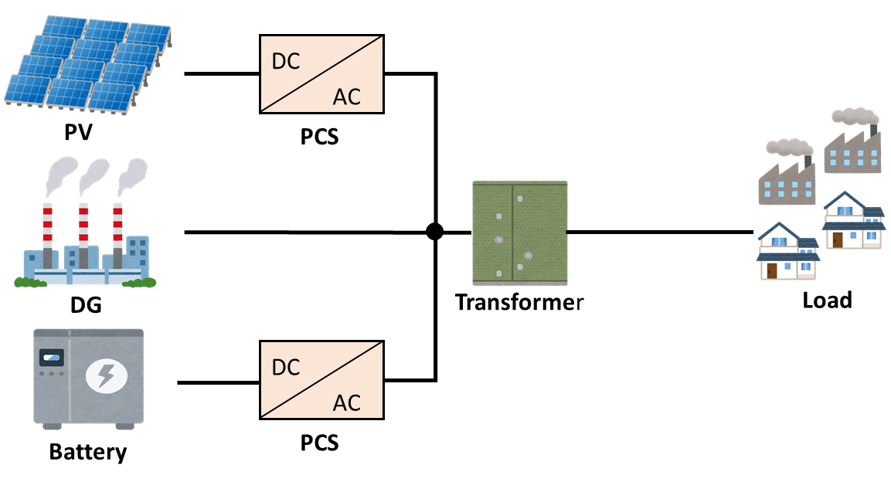
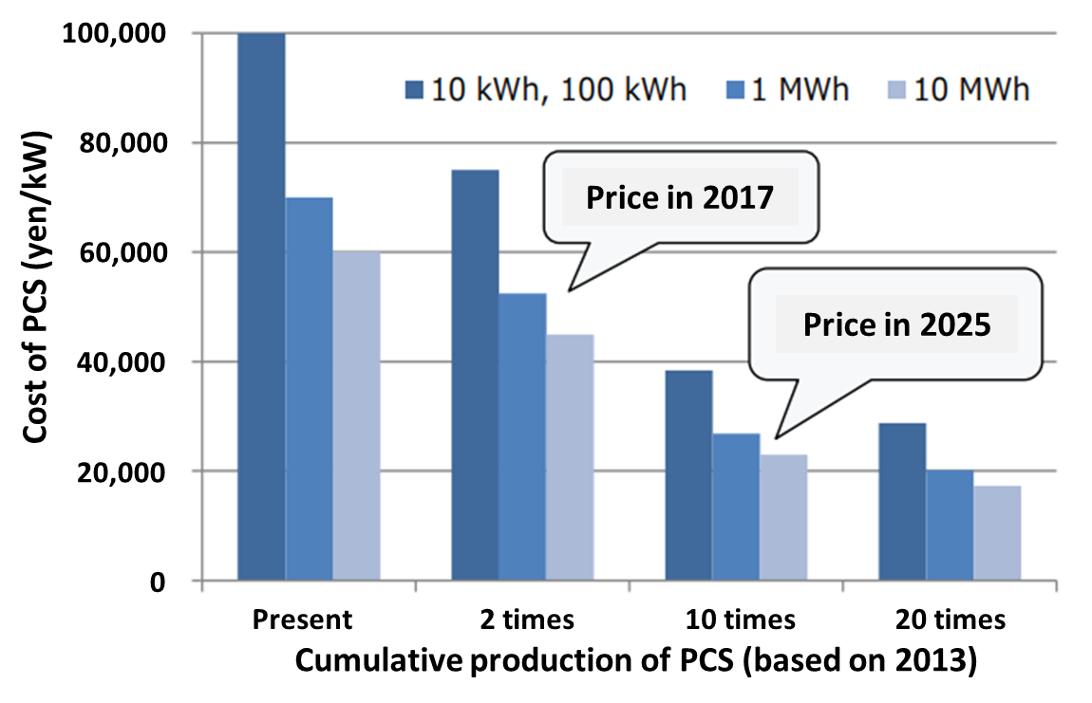
To minimize the operation cost of system
Establish the optimum capacity and control logic of Power Conditioning System(PCS) of battery
【What is PCS ?】
PCS is a device that converts DC power generated by PV and battery into AC
Fig.3 Example of PCS
Fig.4 PCS of battery price tends^{[2]}
・If PCS capacity of battery changes by 1kW, the PCS cost of battery changes significantly
・Control logic changes charge and discharge operation and changes battery capacity
Ref[2]: Ministry of Economy, Trade and Industry『www.meti.go.jp/meti_lib/report/2016fy/000300.pdf』

Slide 4
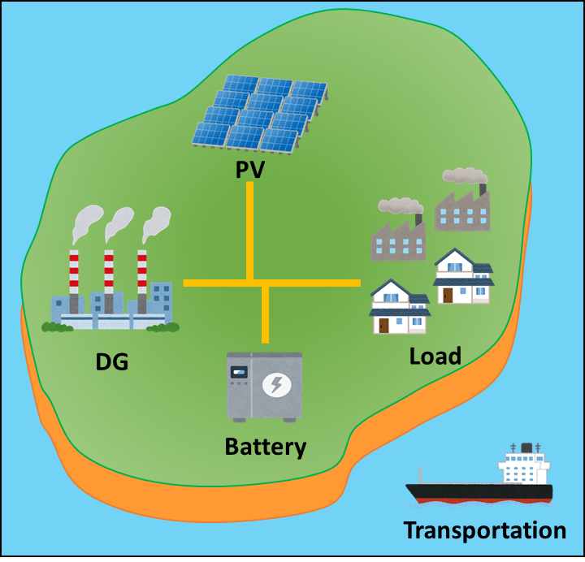
Optimum design for PCS in small island DG-PV-BESS hybrid microgrid
【Objectives】
・Establish the PCS control logic of battery that can control output for system stabilization
・Establish the optimal PCS sizing of battery to control supply and demand fluctuation
【Research plan】
Step 1
Investigate the factors related to stability of microgrid
Step 2
Research on examples of microgrid
Step 3
Set up the analytical model
Step 4
Step 5
Step 6
Construct the control logic
Simulate the sizing and control logic
Develop the study method of optimal PCS capacity
Fig.5 Image of isolated island grid

